Slide 1
Security and Communication
Notes:
[Sources]
- Template: A4.M2 Multimedia-Audio(2).pptx
[/Sources]

Slide 2
Security Software
A.5.M5 | Theory
Each tool checks a different area of the computer.
Antivirus
Firewall
Antispyware
Checks
Files and applications
Detects
Viruses and other malware
Action
Quarantine or deletion
Checks
Network traffic
Applies
Access rules
Blocks
Suspicious connections
Checks
Hidden monitoring
Detects
Collection of personal data
Removes
Spyware
Best protection: updated software and careful user choices.
Notes:
[Sources]
- Computer Science Workbook, Grade 10, A.5.M5, Consolidation Activities, pp. 105–108
- Computer Science Notes, Grade 10, Section A.5
[/Sources]

Slide 3
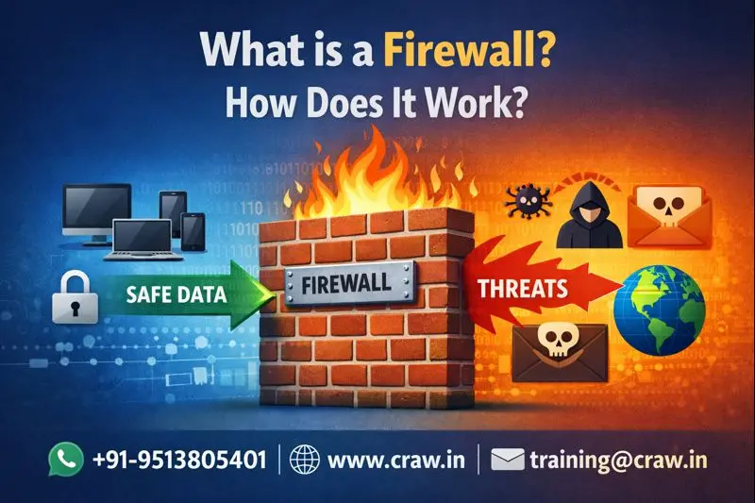
Firewall

Slide 4
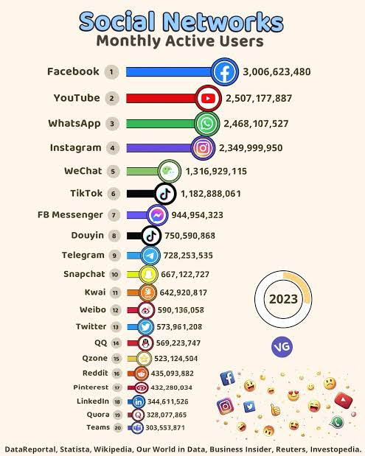
Social Networks
A.5.M5 | Theory
Profile
The user creates a digital profile with information they choose to publish.
Content
Users share text, images and video.
Interaction
They can follow other users, comment and join groups.
Notes:
[Sources]
- Computer Science Workbook, Grade 10, A.5.M5, Consolidation Activities, pp. 105–108
- Computer Science Notes, Grade 10, Section A.5
[/Sources]

Slide 5
Personal Data
A.5.M5 | Theory
Every post involves three important decisions.
1. What do I share?
2. Who can see it?
3. What remains?
Examples
Address and telephone number
Photos
School or location
I avoid details that reveal who I am or where I am.
→
Privacy settings
Friends only or specific people
Review connection requests
They limit the audience, but someone may keep a copy.
→
Digital footprint
A post may be:
• copied
• shared again
• remain available
Deleting it does not guarantee that it is gone.
Example: a photo with location enabled can reveal where you are.
https://www.youtube.com/watch?v=F7pYHN9iC9I
Notes:
[Sources]
- Computer Science Workbook, Grade 10, A.5.M5, Consolidation Activities, pp. 105–108
- Computer Science Notes, Grade 10, Section A.5
[/Sources]

Slide 6
Phishing (credential theft)
A fraudulent message that tries to steal passwords, bank details or other personal information.
SUSPICIOUS MESSAGE
From: support@my-bank-security.com
Subject: URGENT: Your account will be locked
Open the link and enter your password:
http://my-bank-secure-login.example
1
Suspicious sender
The address looks official, but it is not the real one.
2
Pressure and urgency
The message creates fear so that you act quickly.
3
Requests sensitive information
A legitimate service does not ask for your password through a link.
4
Strange link
We check the real domain carefully before clicking.
Do not click the link. Open the official app or website yourself.
Notes:
[Sources]
- Computer Science Workbook, Grade 10, A.5.M5, Consolidation Activities, pp. 105–108
- Computer Science Notes, Grade 10, Section A.5
[/Sources]

Slide 7
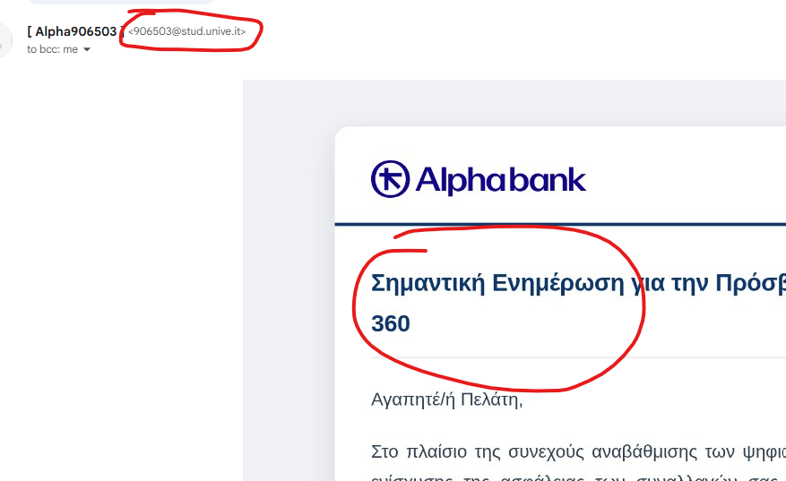
Phishing (credential theft)

Slide 8
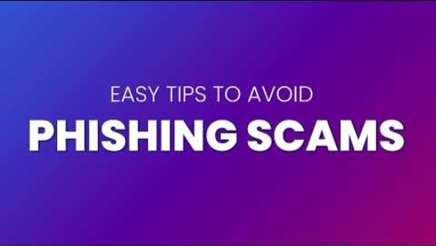
Phishing (credential theft)
https://youtu.be/JlQovysQBn0?si=QMoSt00HCt6g_sKI
Notes:
[Sources]
- Computer Science Workbook, Grade 10, A.5.M5, Consolidation Activities, pp. 105–108
- Computer Science Notes, Grade 10, Section A.5
[/Sources]

Slide 9
Online Risks
A.5.M5 | Theory
Two different risks require immediate help and reporting.
Grooming (manipulation of a minor)
Cyberbullying (Online harassment)
How it develops
1. Fake identity
2. Gradually gains trust
3. Asks for secrecy, photos or a meeting
Warning: asks to keep the conversation secret.
How it appears
1. Repeated insulting messages
2. Threats or humiliating posts
3. Sharing content without permission
Warning: it repeats and causes fear or pressure.
What I do
1. I do not reply
2. I keep evidence
3. I block and report
4. I tell a trusted adult
Notes:
[Sources]
- Computer Science Workbook, Grade 10, A.5.M5, Consolidation Activities, pp. 105–108
- Computer Science Notes, Grade 10, Section A.5
[/Sources]

Slide 10
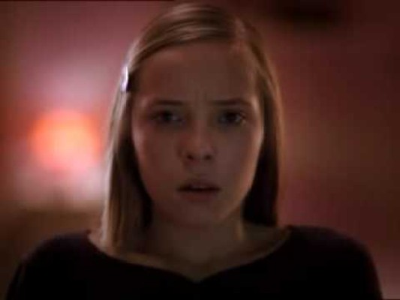
Cyberbullying (Online harassment)

Slide 11

Grooming (manipulation of a minor)

Slide 12
Consolidation Activities
A.5.M5
To be completed
Questions 1–17 from Worksheet A.5.M5.
Notes:
[Sources]
- Computer Science Workbook, Grade 10, A.5.M5, Consolidation Activities, pp. 105–108
- Computer Science Notes, Grade 10, Section A.5
[/Sources]

